Slide 1
What is avidpay?
The Trust has partnered with AvidXchange, implementing the AvidPay solution to:
  Print and mail client AP checks
  Provide client vendors with (faster) electronic payment options
  Providing additional internal controls
      Payment Review
      Positive Pay

Slide 2
How AvidPay Works
Invoices will go into Invoice Manager for approval by manager
Once approved the Invoice goes into Trustlink for check processing
Checks issued from Operating with Trust signatures will be flagged, as processed thru AvidPay. (No Reserve checks are paid using AvidPay).
A check file is sent to AvidPay daily (and will be used in the Positive Pay process)
AvidPay will draft the HOA bank account and print and mail the checks from their location.
So What is Different?
Trustlink will continue to show a check number that matches the withdrawal on the bank account
Checks will be drawn from an AvidPay bank account, as the HOA bank has already been drafted
The checks received by the vendor will not have Trust signatures
Check copies will no longer be available in the financial packets. (However, cleared check transactions will be shown on the client bank statement)

Slide 3
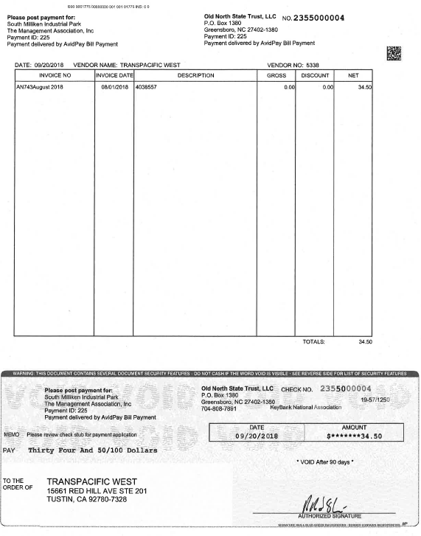
AvidPay Check Example:
Payment ID = Trustlink Check Number
Actual Check Number is from Avid Pay and not listed in Trustlink
Check is drawn off an AvidPay bank account not the HOA bank account number
Signature is not a Trust signature.
Check is mailed from North Carolina

Slide 4
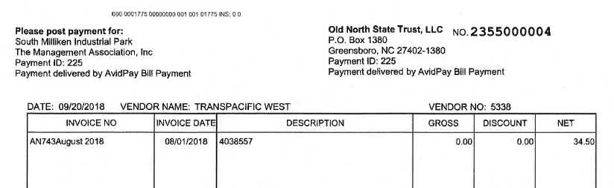
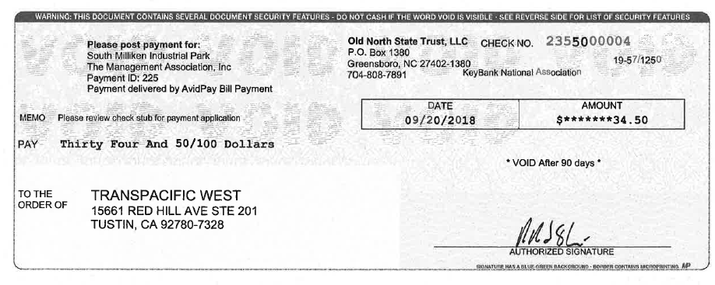
Actual AvidPay Check Number
Trust Link Check Number
Check drawn off AvidPay bank
Not a Trust Signature

Slide 5
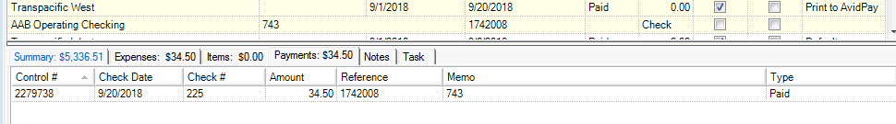
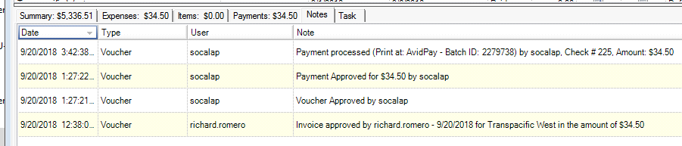
Where to look in Accounts Payable:
Check # in TrustLink
Shows Print to Avid Pay
In the Notes tab it shows payment was processed – Print to AvidPay

Slide 6
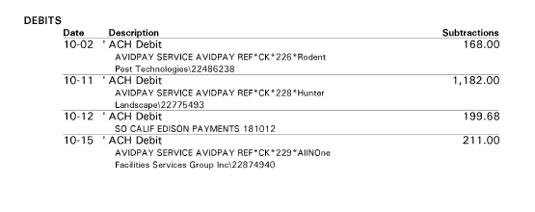
AAB Client Bank Statement Example
Check # in TrustLink matches draft # in Bank Statement

Slide 7
Stop Payment process
A request is sent to the AP Specialist to place a stop payment on a check
AP Specialist will contact AvidPay to request the stop payment and notify the Staff Accountant
The Staff Accountant will monitor the HOA bank account to determine when funds have been received for the stop payment (i.e. returned by Avid Pay)
Once funds are received the staff accountant notifies AP to void the payment in TrustLink
AP will void the payment in Trust Link. If the invoice will be paid with a new check, the invoice will be re-processed and available in Invoice Manager for CAM review.

Slide 8
Electronic Vendor Payment Options
Electronic Options – vendors are paid faster than check processing (bypassing US mail)
Virtual Credit Card Small fee to the vendor 1-2%
Requires vendor have Merchant Services (Credit Card Processing)
Fastest payment option – approx. 2 days
Direct Deposit Small fee to the vendor 1-2%
Merchant Services not needed
Payment available approx. 3 days
Managers do not need to do anything. AvidPay will reach out to all vendors regarding these options…

Slide 9
Added Security thru positive pay
The AvidPay process includes additional security, using Positive Pay on all checks (i.e. electronically verified against a daily pay file).
Verification of the following is performed
      Payee
      Check Date
      Amount
      Check Number

Slide 10
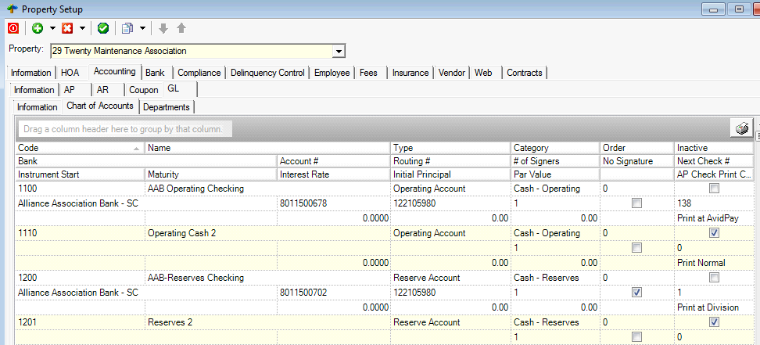
Setup of AvidPay in Trustlink
Set up of AvidPay is done thru Property Set up in Trust Link. The accounts designated to be included in the daily pay file are marked as “Print at AvidPay” by the Controller.
IT team will set-up initially, but review of initial set-up and updates will be processed by the Controller

